Slide 1

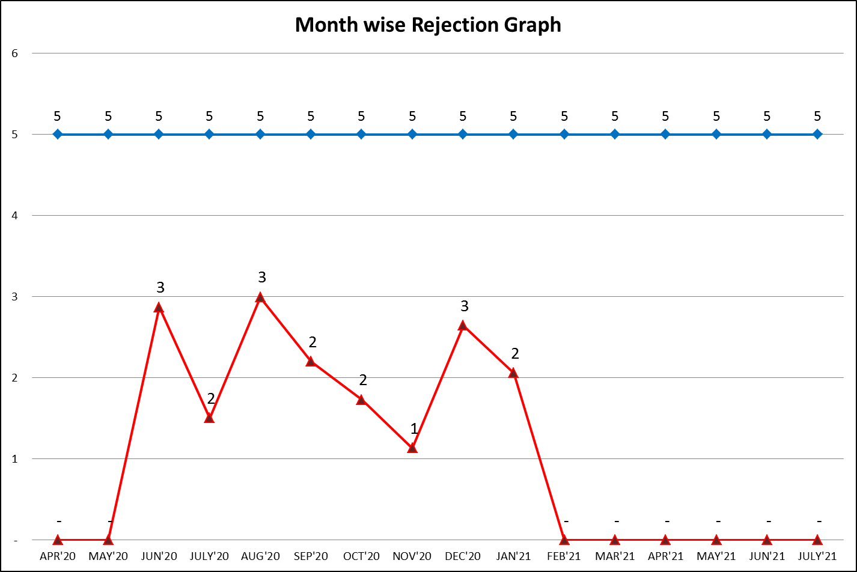
IQC

Slide 2
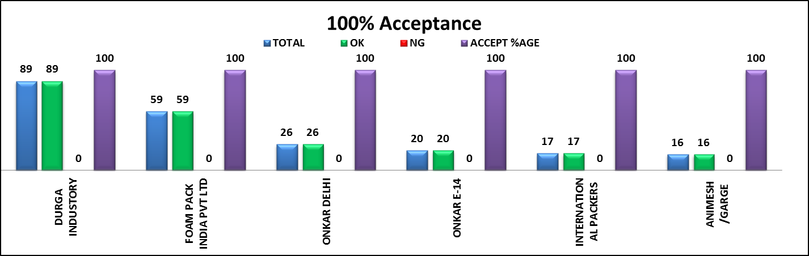
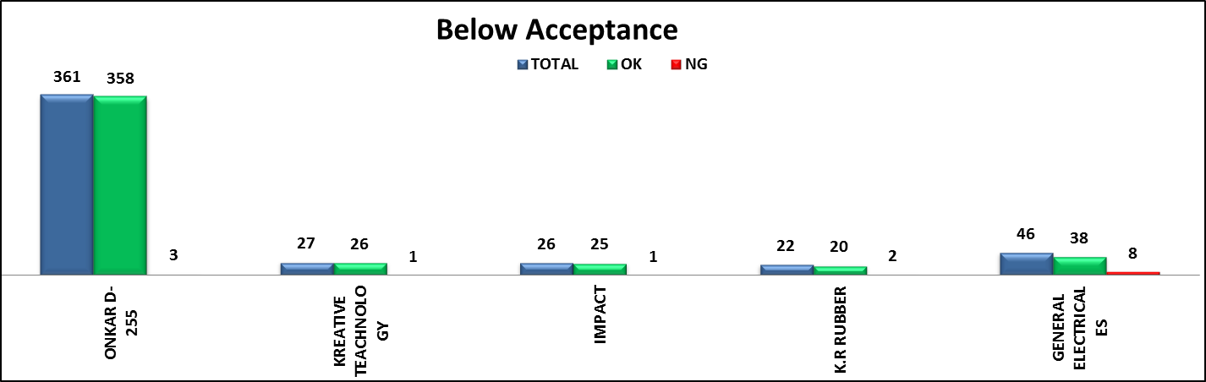
IQC

Slide 3
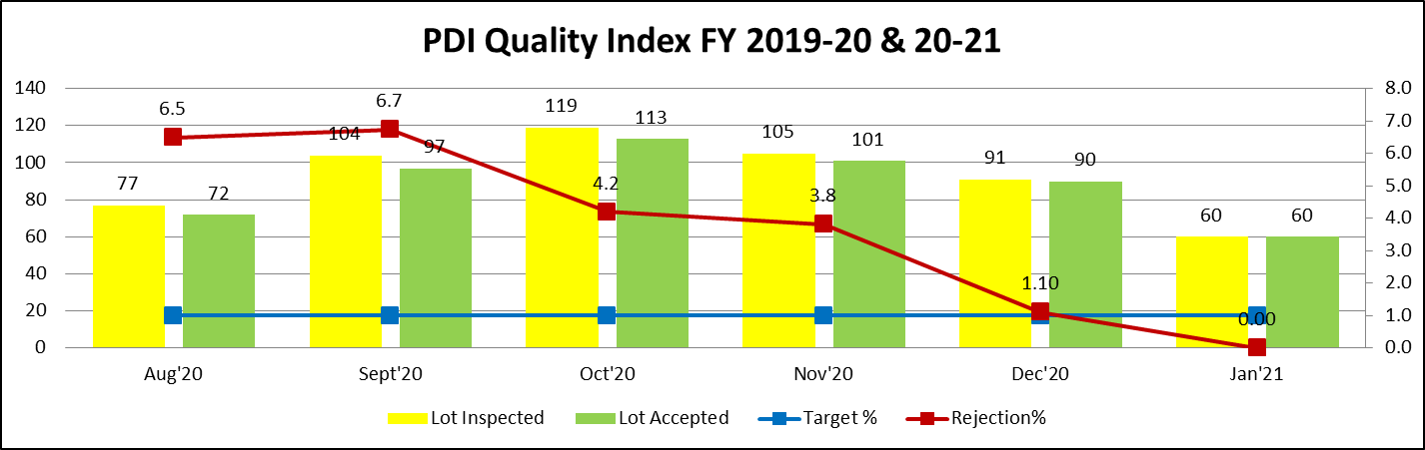
PDI
Sr.No | Month | Issue | Root Cause | Action Plan | Trg Date | Resp. | Status
1 | Oct'20 | 7" cut out instead of 11" | During model change both cutout mix at line | Seprate location provided for cutout & given proper training | 10.10.20 | Prod. | Done
2 | Oct'20 | Scratches & cleaning | PUF Die is not proper cleaned New person deputed on cleaning without proper training | Die clean every 2 hrs. Proper training imparted | 16.10.20 | Quality | Done
3 | Oct'20 | PDP shrinkage on packing box | Packing box in wet condition | Segregation & dry by fan air | 19.10.20 | Prod. | Done
4 | Oct'20 | Scratches & cleaning | EPE foam Thermocol life is over | Change EPE foam thermocol within every 3 months | 29.10.20 | Prod. | Done
5 | Oct'20 | Top cover scratches | EPE foam Thermocol life is over | Change EPE foam thermocol within every 3 months | 29.10.20 | Prod. | Done
6 | Nov'20 | Scratches & Clamp Issue | During welding clamp out & fixture play Rough surface on cleaning table | Given new fixture EPE foam pasted on cleaning table | 05.11.20 | Prod. | Done
7 | Nov'20 | Coating break near neck ring | Primer coating fixture wear out | New fixture provided | 06.11.20 | Prod. | Done
8 | Nov'20 | Cut out not cut on specific range (2) | 1°C variation in bath testing and water not circulate properly | Motor (Pump) changed & monitoring | 11.11.20 | Prod. | Done
9 | Dec'20 | PDP sticker wrong pasted | Separate Location not define at line | Separate location define to avoid to mix PDP sticker & Bin provided in store to kept separately PDP sticker | 21.12.20 | Prod. | Done

Slide 4
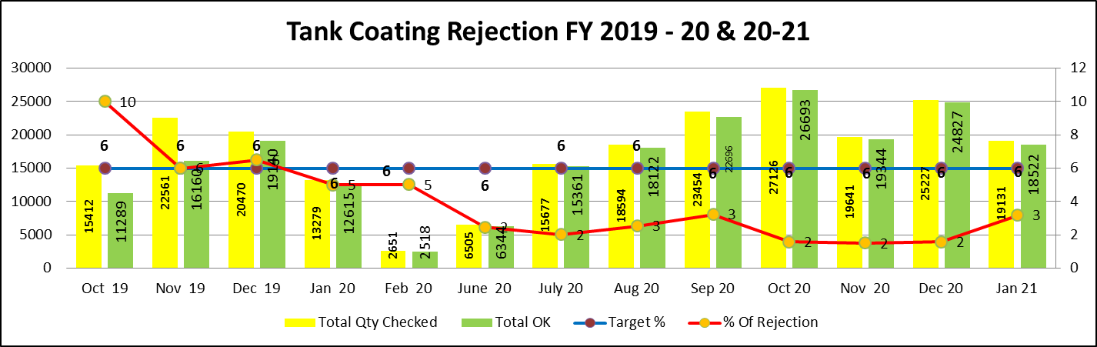
Process Rejection Trend Tank Coating
Sr.No | Month | Issue | Root Cause | Action Plan | Trg Date | Resp. | Status
1 | Oct-19 | Pin Hole | 1- Out of 6 Robotics gun 3 gun charging was not up to mark 2- Oven temperature | 1- Gun replaced 2- TTR done & observed OK | 12.10.19 | Prod. | Done

Slide 5
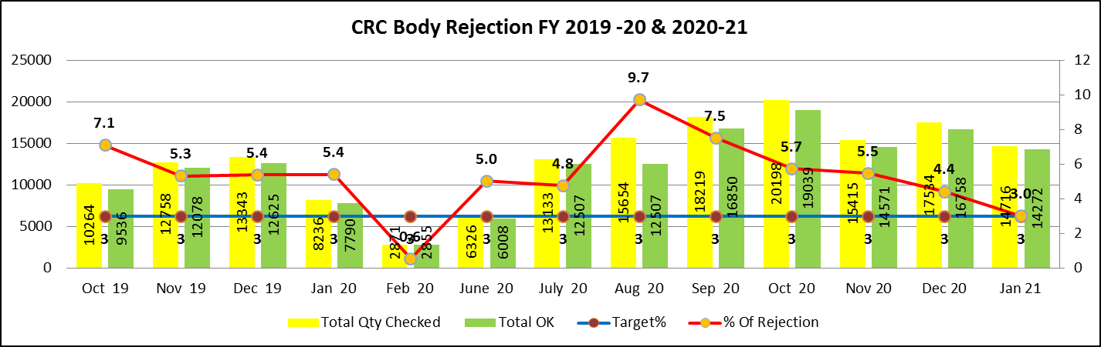
CRC Body Rejection
S.No | Month | Issue | Root Cause | Action Plan | Trg Date | Resp. | Status
1 | Sep 20 | Body Dent | Handling issue | Decide in MRM to fabrication of CRC body in-house | 05.10.20 | OEGPL D-255 | Close
2 | Oct 20 | Body Dent | Handling issue | feedback given to improve handling | 08.11.20 | OEGPL D-255 | Close
3 | Nov 20 | Body Dent | Handling issue | feedback given to improve handling | 07.12.20 | OEGPL D-255 | Close
4 | Dec 20 | Body Dent | Handling issue | feedback given to improve handling | 05.01.21 | OEGPL D-255 | Close

Slide 6
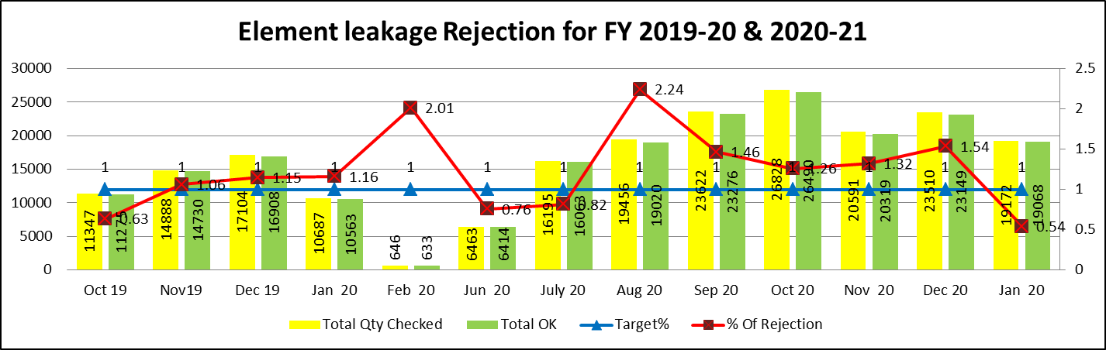
Process Rejection Trend Element Leakage
Sr.No | Month | Issue | Root Cause | Action Plan | Trg Date | Resp. | Status
1 | Oct 20 | Element Leakage | Machine under capacity | New setup to be purchased | 04.11.20 | Durga D-38 | Done
2 | Nov 20 | Element Leakage | Element cup plate step height out of specification | Tool issue & 100% recheck at supplier end | 10.12.20 | Durga D-38 | Done
3 | Dec 20 | Element Leakage | Element cup plate step height out of specification | Tool rectify / New leakage machine installed & Validation lot pending | 03.01.21 | Durga D-38 | Done

Slide 7
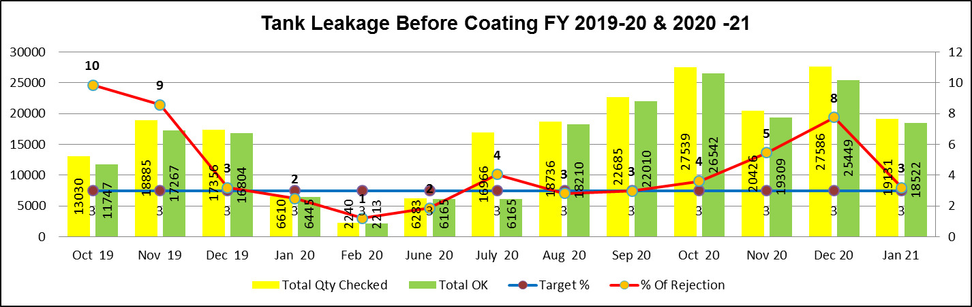
Tank Leakage before Coating
Sr.No | Month | Issue | Root Cause | Action Plan | Trg Date | Resp. | Status
1 | Oct 20 | Tank Leakage | Sol. Qube leakage testing fixture non availability | Leakage testing fixture repaired | 11.11.20 | OEGPL D-255 | Done
2 | Nov 20 | Tank Leakage | Supplier machine breakdown | On deviation/ 100% check our end | 03.12.20 | OEGPL D-255 | Done
3 | Dec 20 | Tank Leakage | 1. Supplier machine breakdown 2. Spare part not available as per requirement | machine will be repaired | 05.01.21 | OEGPL D-255 | Done

Slide 8
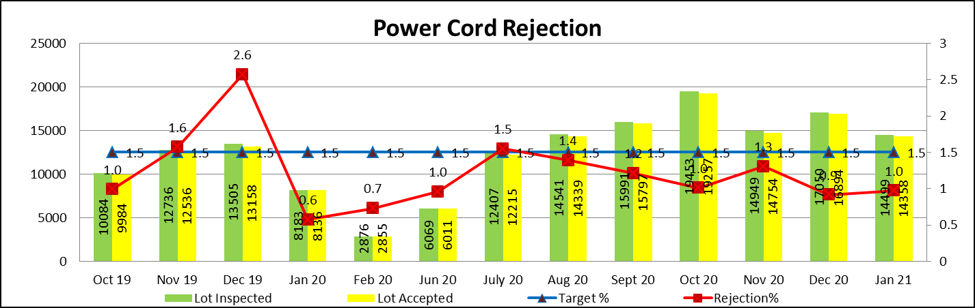
Power Cord Rejection (Amica) FY 2019-20 & 2020-21
Sr.No | Month | Issue | Root Cause | Action Plan | Trg Date | Resp. | Status
1 | Dec-19 | Power Cord pin dent | Transport & Handling dent | Power cord segregated & return back to supplier. Handling issue improved at supplier end | 09.01.20 | Vendor | Done

Slide 9
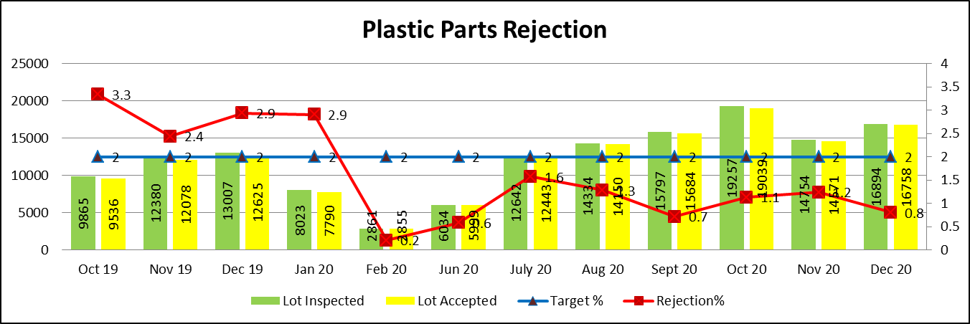
Plastic Parts Rejection (Amica) FY 2019-20 & 2020-21
Sr.No | Month | Issue | Root Cause | Action Plan | Trg Date | Resp. | Status
1 | Oct-19 | Scratches | Wrong Handling | Proper material packed in poly bag & box | 07.11.19 | Prod. | Done
2 | Nov-19 | Shrinkage | Parameter not maintain (temp. issue) | Parameter to be maintain & first part check by concern person | 09.12.19 | Prod. | Done
3 | Dec-19 | Color mismatch & Broken | Material not as per requirement | Material send back to supplier & First lot trail then lot except | 05.01.20 | Prod. | Done
4 | Jan-20 | Water marks & Scratches | Mold issue | Mold polishing | 07.02.20 | Prod. | Done

Slide 10
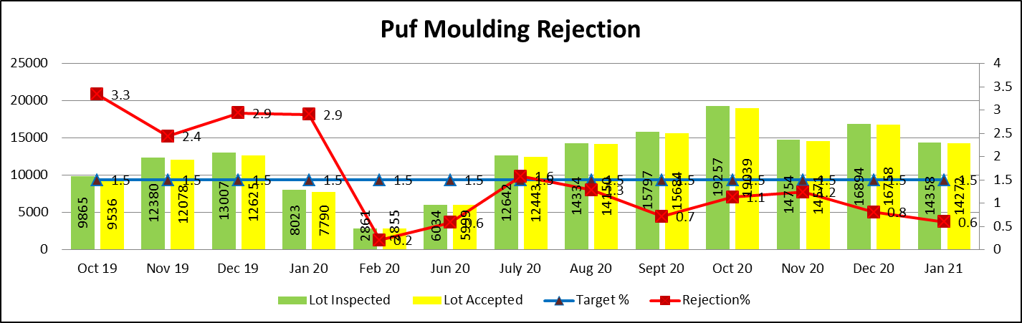
Puf molding Rejection (Amica) FY 2019-20 & 2020-21
Sr.No | Month | Issue | Root Cause | Action Plan | Trg Date | Resp. | Status
1 | July-20 | Puff Short | Less Pressure due to compressor not working | Compressor repaired | 07.08.20 | Maint. | Done
2 | Oct-20 | Puff Short | Chemical Issue | Chemical send back to supplier | 08.11.20 | Purchase | Done

Slide 11
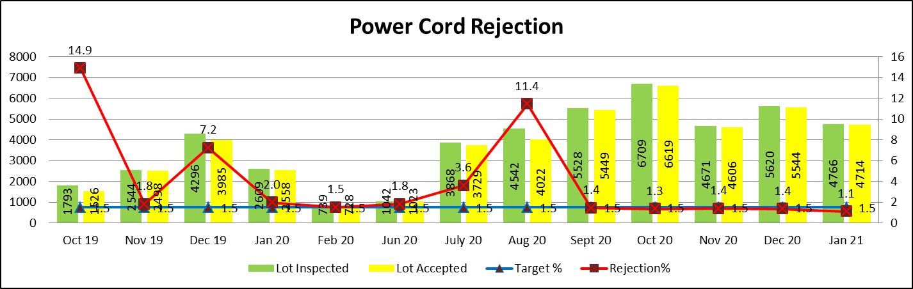
Power Cord Rejection (Qube) FY 2019-20 & 2020-21
Sr.No | Month | Issue | Root Cause | Action Plan | Trg Date | Resp. | Status
1 | Oct-19 | Power Cord pin dent | Transport & Handling dent | Power cord segregated & return back to supplier. Handling issue improved at supplier end | 09.11.19 | Bonex | Done
2 | Dec-19 | Thimble over size | Thimble mix during operation | Power cord segregated & return back to supplier. | 08.01.20 | Bonex | Done
3 | Jul-20 | Power Cord pin dent | Transport & Handling dent | Power cord segregated & return back to supplier. Handling issue improved at supplier end | 09.01.20 | Safecord | Done
4 | Aug-20 | Power Cord Break & Damage | Not cutting properly during cutting operation | Power cord segregated & return back to supplier. | 10.09.20 | Safecord | Done

Slide 12
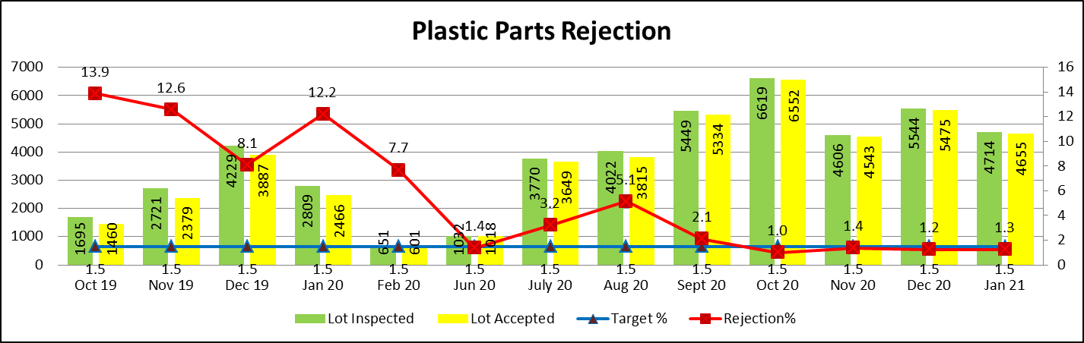
Plastic Parts Rejection (Qube) FY 2019-20 & 2020-21
Sr.No | Month | Issue | Root Cause | Action Plan | Trg Date | Resp. | Status
1 | Jan-20 | Water marks & Scratches (Top Cover) | Mold issue | Mold polishing to avoid flow marks | 07.02.20 | Prod. | Done
2 | Feb-20 | Water marks & Scratches (Bottom Cover) | Mold issue | Mold polishing to avoid flow marks | 07.02.20 | Prod. | Done
3 | Jul-20 | Color Variation (Top & Bottom Cover)` | Material Issue | On Deviation | 12.07.20 | Prod. | Done
4 | Aug-20 | Black Spot | Material Issue | Material send back to supplier | 11.09.20 | Prod. | Done

Slide 13
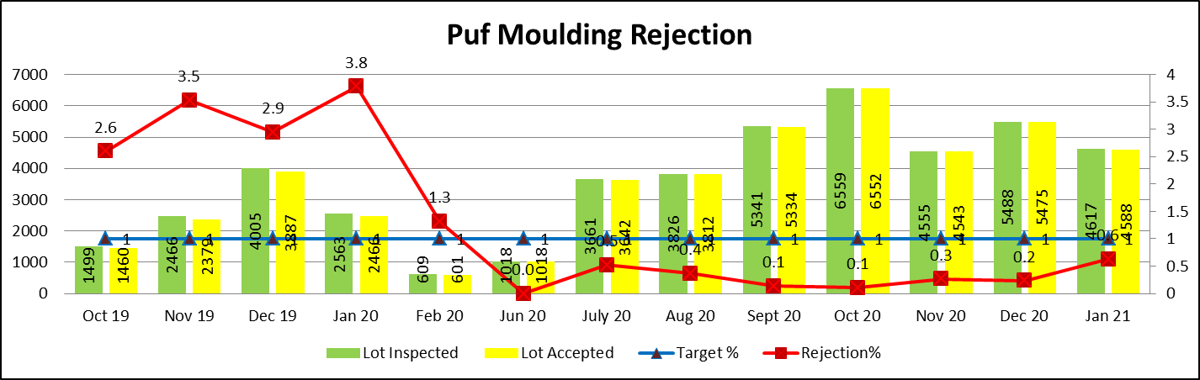
Puf molding Rejection (Qube) FY 2019-20 & 2020-21
S.No | Month | Issue | Root Cause | Action Plan | Trg Date | Resp. | Status
1 | Oct-19 | Puf Puncture (15 ltr) | Top & Bottom cover peorperly not lock | Mould Rectification | 09.11.19 | Tooling | Done
2 | Nov-19 | Puff Short | Chemical Issue | Chemical send back to supplier | 08.11.20 | Purchase | Done
3 | Dec-19 | Puf Puncture (25 ltr) | Top & Bottom cover properly not lock | Mould Rectification | 07.02.20 | Tooling | Done
4 | Jan-20 | Puff Short | Less Pressure due to compressure not working | Compressure repaired | 09.02.20 | Maint. | Done

Slide 14
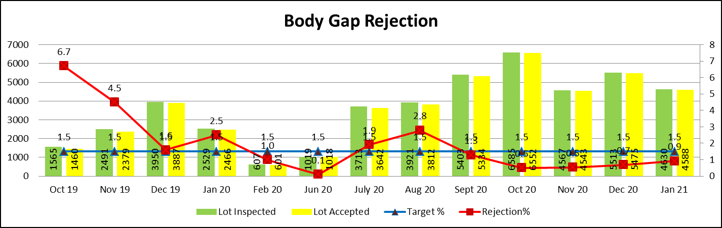
Body Rejection (Qube) FY 2019-20 & 2020-21
Sr.No | Month | Issue | Root Cause | Action Plan | Trg Date | Resp. | Status
1 | Oct-19 | Over Puf | IP ratio not maintain as per requirement | IP ratio to maintain as per WI | 10.11.19 | Prod. | Done
2 | Nov-19 | Lock fittment | Tooling Issue | Tool Rectification | 08.12.19 | Tooling | Done
3 | Jan-20 | Lock fittment | Tooling Issue | Tool Rectification | 03.01.20 | Tooling | Done
4 | Aug-20 | U Clamp Fittment | U clamp out during tank welding | Seggregated & return back to supplier. | 06.08.20 | Tooling | Done

